Slide 1

KIT - KalaignarKarunanidhi Institute of Technology ( An Autonomous Institution )
Department of Computer Applications
M23CAP401 - PROJECT WORK
VIVA VOCE
GUIDED BY,
PRESENTED BY,
Ms. M. UMAMAHESWARI MCA, (Ph.D)
ASSISTANT PROFESSOR,
DEPARTMENT OF MCA.
NAME : SHREESUTHAN M C,
REG NO : 711523MMC051,
II - MCA.

Slide 2
PROJECT TITLE
INTRUSION DETECTION TECHNIQUES IN DATA DISTRIBUTION

Slide 3
ABSTRACT
This project, "Intrusion Detection Techniques in Data Distribution," aims to enhance data security by implementing advanced detection and prevention mechanisms.
Instead of traditional watermarking methods, our approach uses unobtrusive detection techniques to efficiently trace leaked data.
Additionally, fake object injection is utilized to insert realistic but non-sensitive records into datasets, improving breach detection.
To further strengthen security, the system employs key-based encryption using a KeyGen algorithm for controlled data access.
By combining Multi-level authentication and data dynamics, this system effectively mitigates insider threats, unauthorized access, and data breaches while maintaining seamless data distribution.

Slide 4
OBJECTIVES
Implement key-based encryption (KeyGen algorithm) to control access and protect sensitive information.
Utilize unobtrusive detection methods and fake object injection to trace unauthorized data breaches efficiently.
Integrate multi-level authentication, including secret keys for file downloads, preventing unauthorized access.
Implement a data dynamics module for file locking and modification restrictions, ensuring data integrity and security.
Identify and track suspicious activities by monitoring data distribution across agents.

Slide 5
EXISTING SYSTEM
Watermarking-Based Detection Systems: Sensitive data is embedded with a unique watermark to trace its origin in case of leaks. This helps identify the source if the data is exposed. However, watermarks can be tampered with, altered, or removed.
Access Control Mechanisms: Role-based access control (RBAC) restricts access to sensitive data, allowing only authorized users to view or modify it. However, it cannot detect insider misuse and does not monitor data after access.
Log-Based Monitoring Systems: Monitors and records user activity to detect suspicious behavior. It does not prevent data leaks and requires manual analysis to identify the responsible user after a breach.
Encryption-Based Security Systems: Data is encrypted before sharing to block unauthorized access, allowing only users with valid decryption keys to view it. However, it does not help identify the source of a data leak.

Slide 6
EXISTING SYSTEM LIMITATIONS
Watermarking can be tampered with, making leak source tracing unreliable.
Access control and encryption can't detect insider misuse.
Existing systems detect breaches only after they occur, not in real time.
Traditional methods fail to track data shared across multiple third parties.

Slide 7
PROPOSED SYSTEM
Fake Object Injection: Inserts realistic but non-sensitive fake records to track leaks and identify guilty agents effectively.
Unobtrusive Detection Methods: Unlike watermarking, this method does not alter original data but still traces unauthorized sharing.
Key-Based Encryption (KeyGen Algorithm): Ensures only authorized users can access data using dynamically generated keys.
Continuous Surveillance: Detects unauthorized access or suspicious downloads in real-time.
User Behavior Analysis: Monitors how data is accessed and flags suspicious activities before a breach occurs.

Slide 8
SYSTEM SPECIFICATIONS
HARDWARE SPECIFICATION
Processor : Intel Core i5 or higher
RAM : Minimum 8GB
Storage : Minimum 5GB HDD
Monitor : Minimum resolution of 1366x768

Slide 9
SYSTEM SPECIFICATIONS
SOFTWARE SPECIFICATION
Front End : React.js
Back End : Node.js, Express.js
Date Base : MongoDB

Slide 10
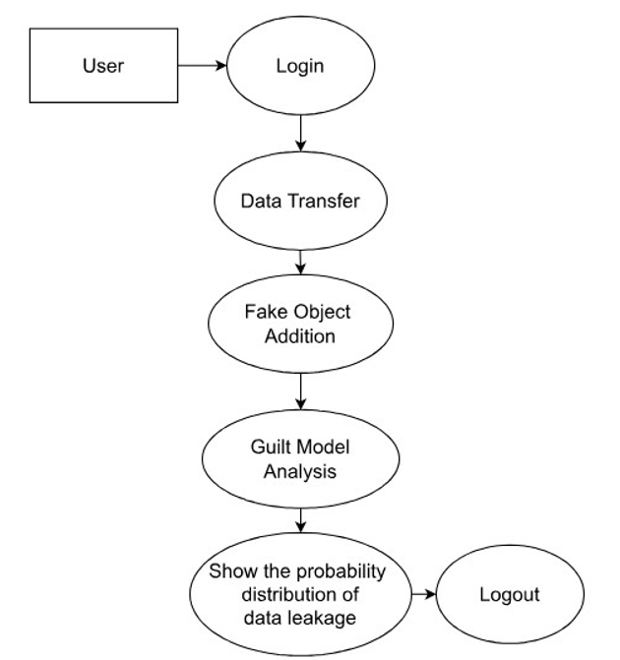
DATA FLOW DIAGRAM

Slide 11
MODULES
Data Allocation module
Fake Object module
Optimization module
Data Distributor module

Slide 12
DATA ALLOCATION MODULE
Divides datasets based on roles, sensitivity, and access policies.
Ensures users or third parties access only necessary data, reducing misuse or leaks.
Maintains logs of data access, including IP addresses, actions, and outcomes for accountability.
Regularly audits data transactions to detect unusual behavior or unauthorized access in real time.

Slide 13
FAKE OBJECT MODULE
Adds fake data that mimics real information to detect unauthorized access.
Sends real-time alerts when fake data is accessed.
Traces breaches to specific users or nodes for quick isolation.
Deters intruders by increasing risk with every unauthorized action.

Slide 14
OPTIMIZATION MODULE
Balances performance and security by adjusting encryption and validation dynamically.
Optimizes resource use by tuning data size and key strength based on user load.
Distributes resources across modules to avoid bottlenecks and ensure smooth operation.
Increases security during threats and scales down in low-risk periods.
Maintains stability and responsiveness under heavy usage or large datasets.

Slide 15
DATA DISTRIBUTOR MODULE
Transmits encrypted data via SSL/TLS with checksums to ensure integrity.
Acts as the final checkpoint to allow access only to verified users.
Uses password login, 2FA, and RBAC for strong multi-level authentication.
Integrates with KeyGen to assign decryption keys based on user roles.
Logs all access attempts and maintains transfer history for audits.
Detects unusual behavior and sends alerts for real-time breach response.

Slide 16
SYSTEM TESTING
Functionality Testing
Usability Testing
Integration Testing
System Testing
Security Testing
Performance Testin

Slide 17
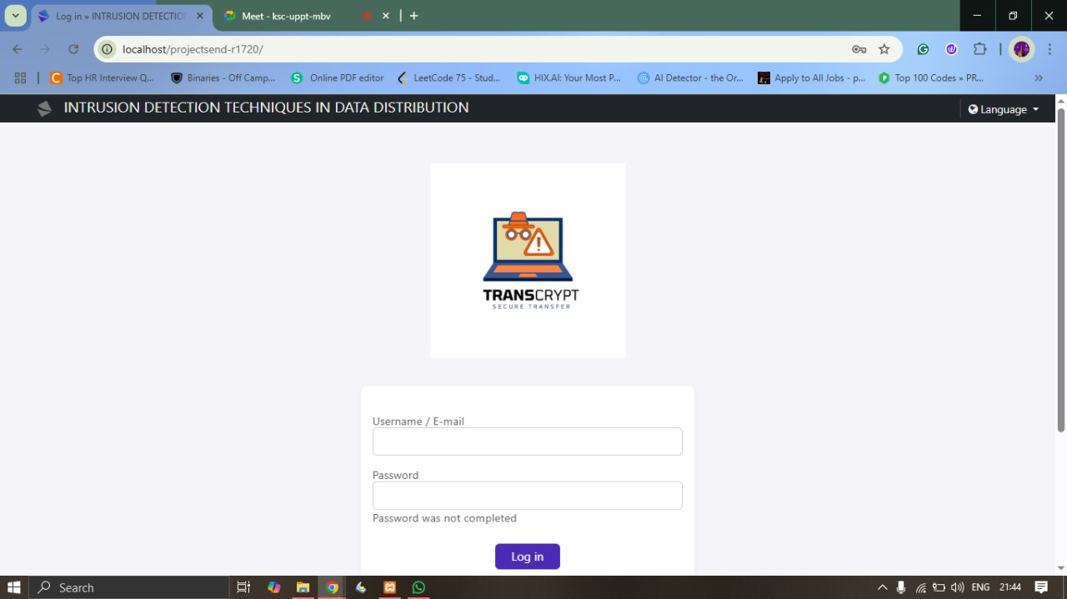
IMPLEMENTATION / RESULTS OF MODULE
Login Page

Slide 18
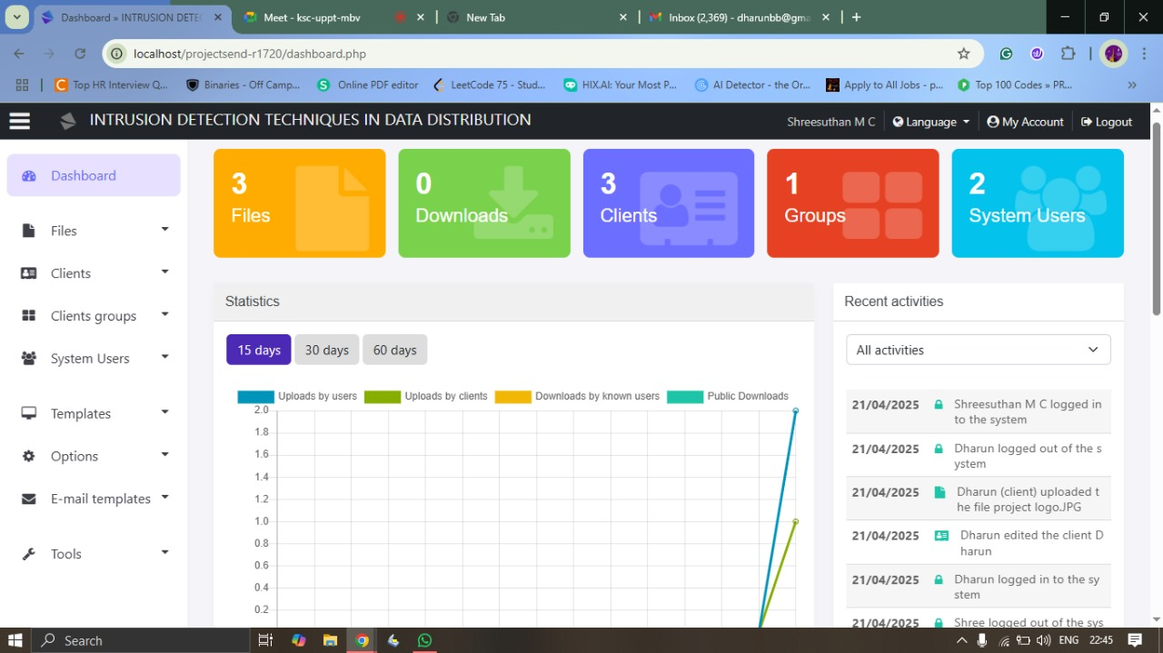
IMPLEMENTATION / RESULTS OF MODULE
Home Page

Slide 19
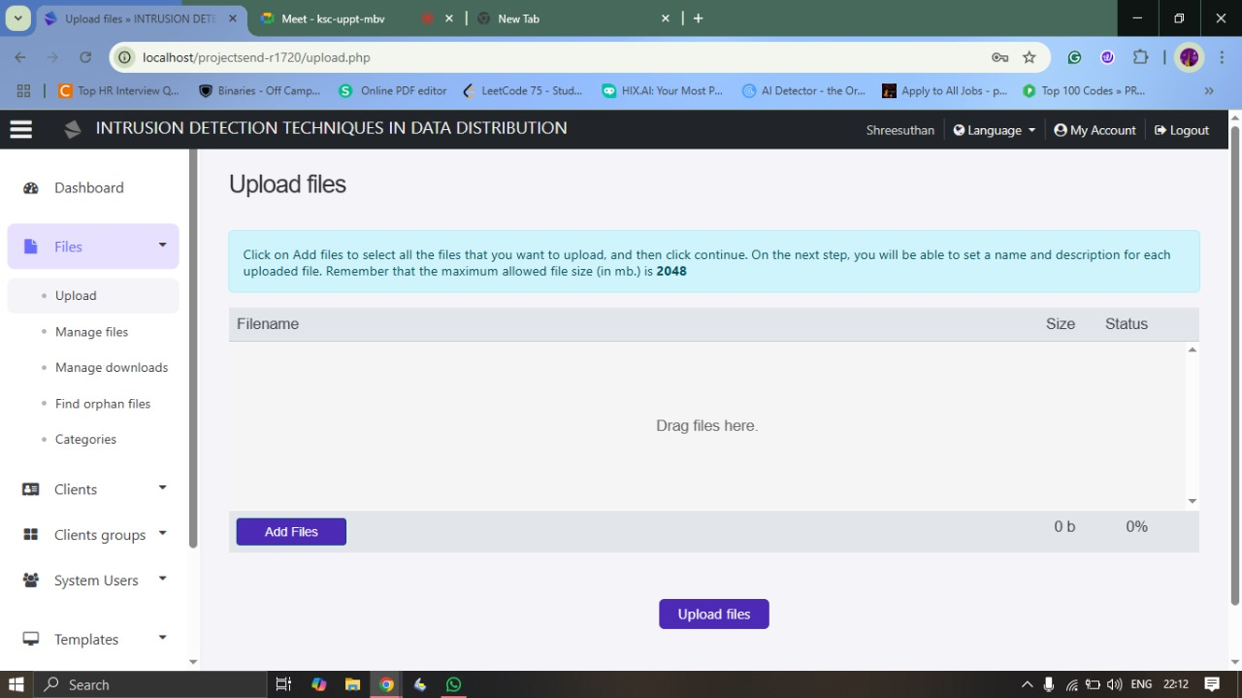
IMPLEMENTATION / RESULTS OF MODULE
Upload Files Page

Slide 20
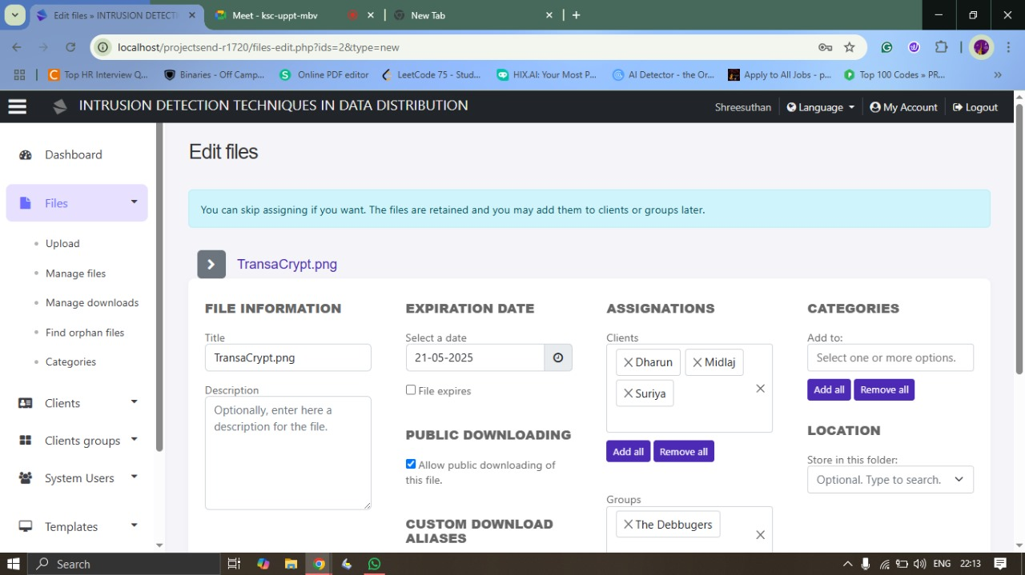
IMPLEMENTATION / RESULTS OF MODULE
Add File Privilege Page

Slide 21
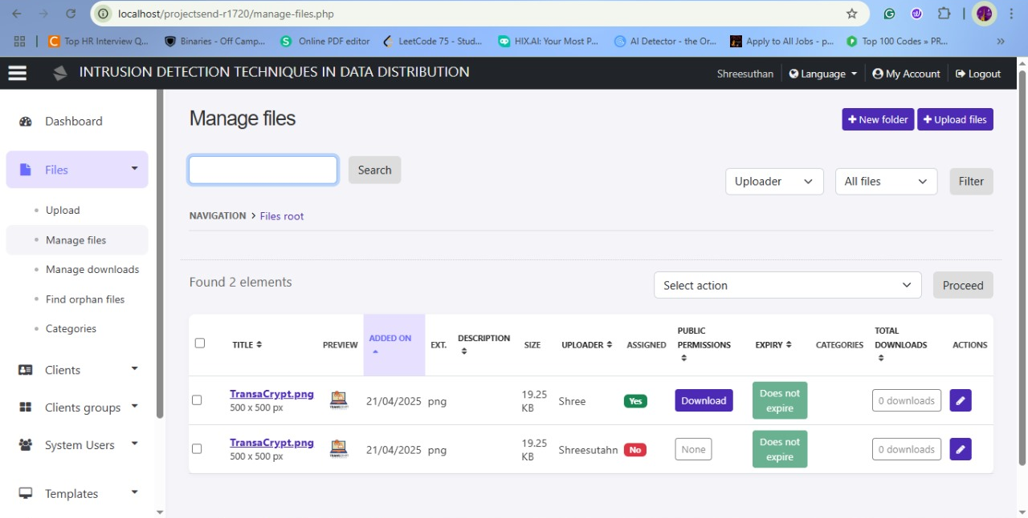
IMPLEMENTATION / RESULTS OF MODULE
File Manage Page

Slide 22
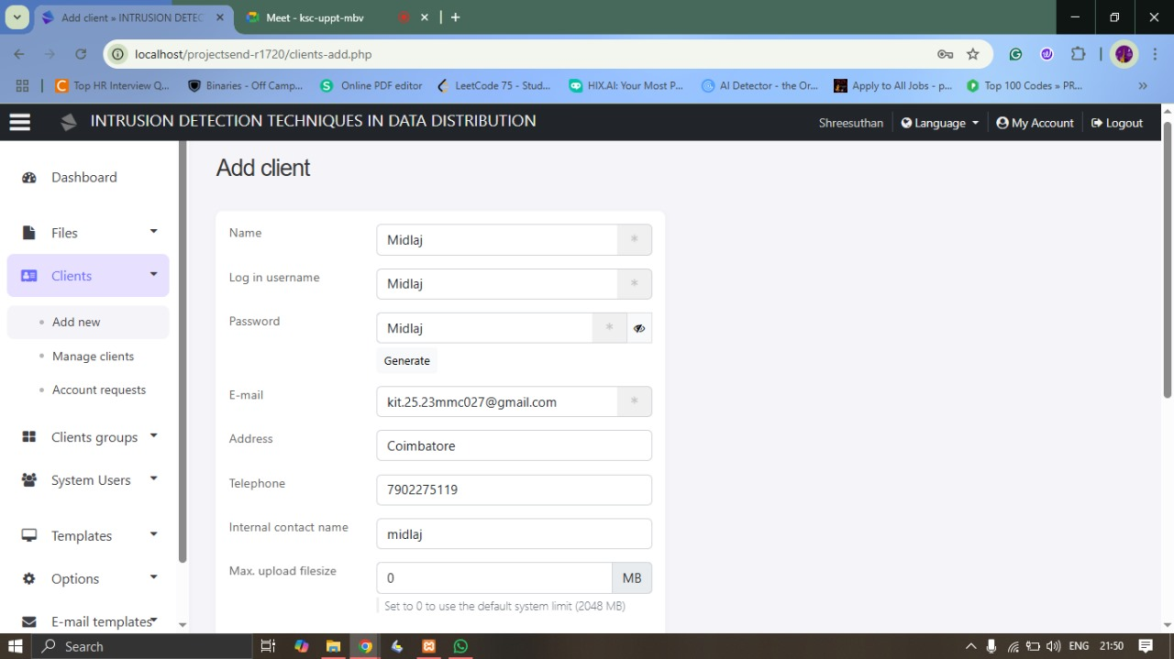
IMPLEMENTATION / RESULTS OF MODULE
Add Client Page

Slide 23
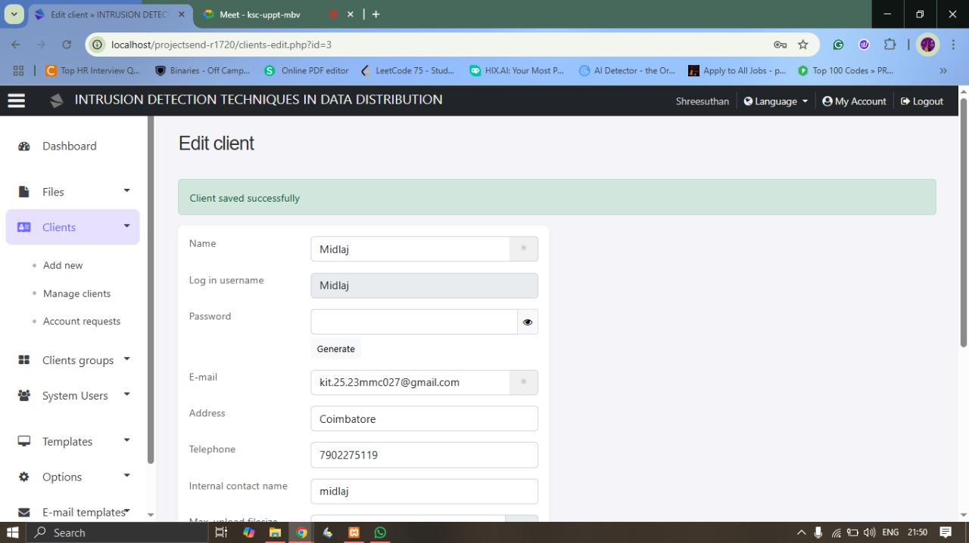
IMPLEMENTATION / RESULTS OF MODULE
Client Added Successfully Page

Slide 24
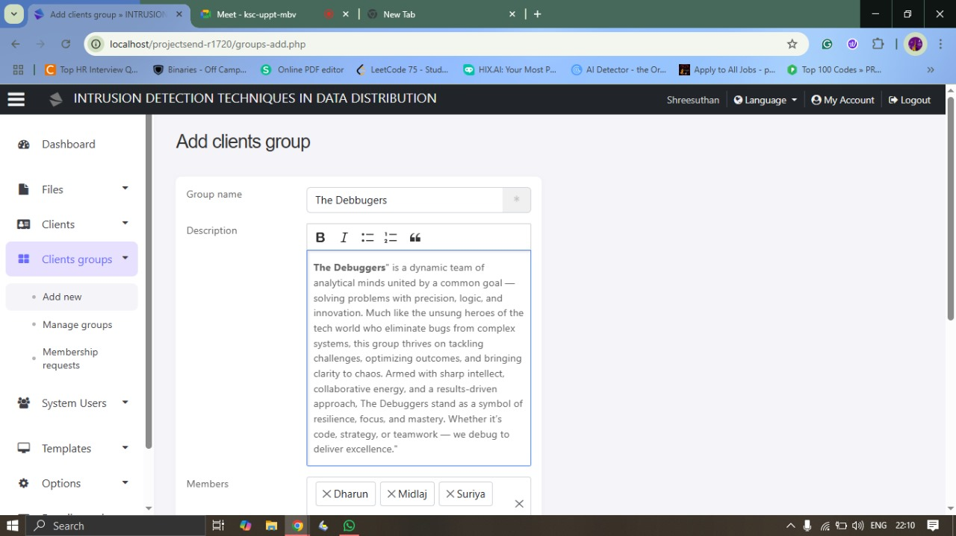
IMPLEMENTATION / RESULTS OF MODULE
Add Group Page

Slide 25
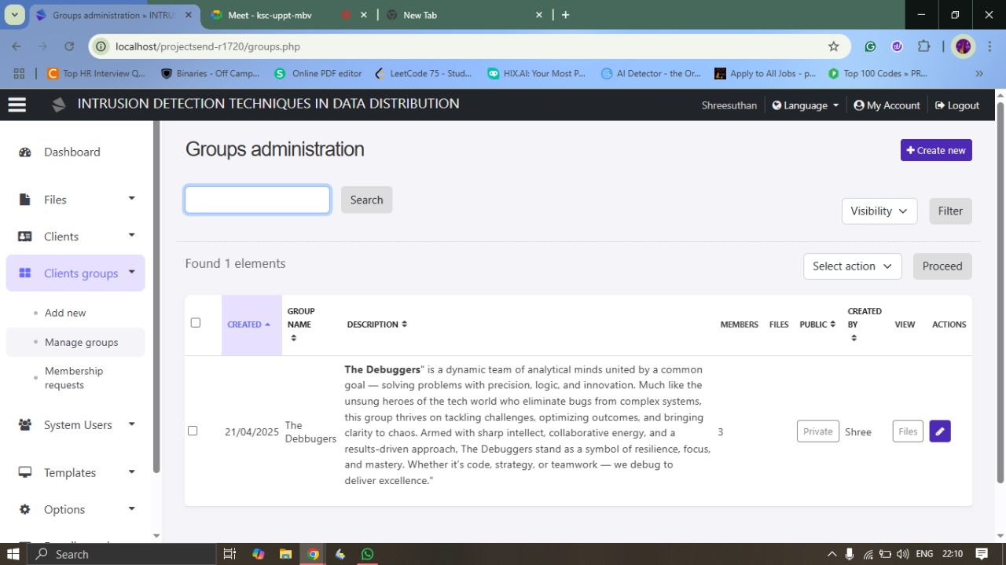
IMPLEMENTATION / RESULTS OF MODULE
Group Created Successfully

Slide 26
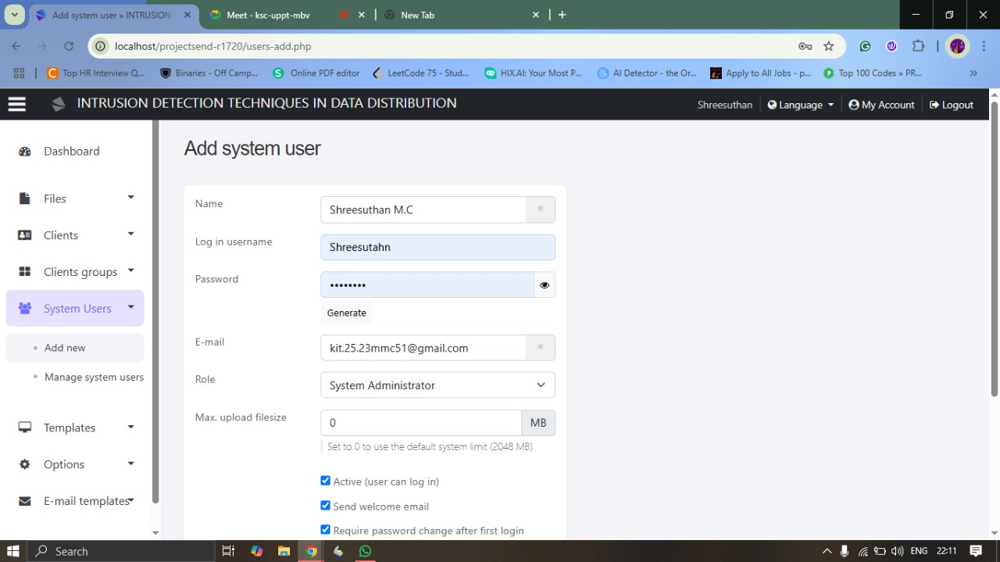
IMPLEMENTATION / RESULTS OF MODULE
Add System User

Slide 27
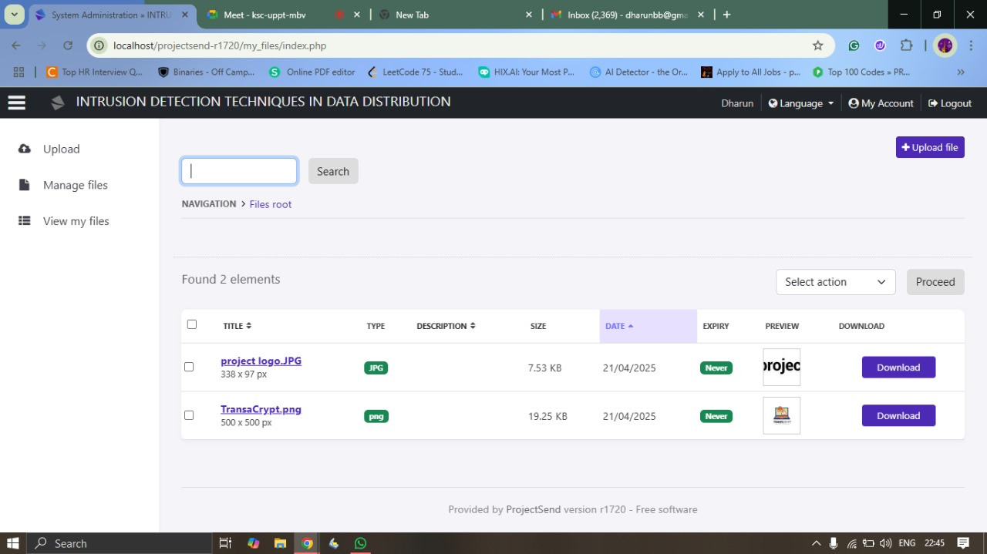
IMPLEMENTATION / RESULTS OF MODULE
Client File Download Page

Slide 28
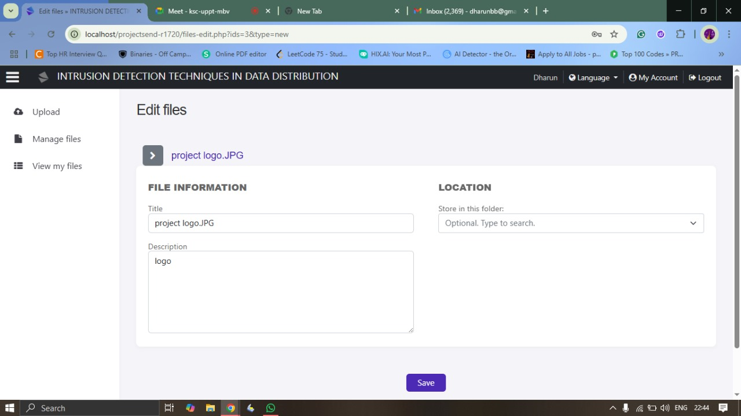
IMPLEMENTATION / RESULTS OF MODULE
Client File Upload Page

Slide 29
CONCLUSION
Secures sensitive data in distributed environments against insider threats and leaks.
Uses fake object injection and probability-based analysis to detect unauthorized access.
Injects decoy data and analyzes behavior to identify leak sources.
Integrates advanced security into the sharing process without adding complexity.
Accurately identifies malicious insiders and promotes accountability.
Scalable for corporate and cloud-based data management use cases.
Achieves strong intrusion detection while maintaining system usability.

Slide 30
FUTURE ENHANCEMENT
AI-Driven Detection: Leverages machine learning to spot user anomalies and trigger automated alerts.
Context-Aware MFA: Uses location, device, and behavior data to adapt multi-factor authentication.
User Experience & Personalization: Enables users to customize settings and access security dashboards.
Real-Time Threat Intelligence: Connects to cybersecurity databases to block known threats proactively.
Compliance Modules: Supports GDPR, HIPAA, and CCPA with audit trails and consent tracking.
Scalability & Future-Readiness: Designed to adapt to new threats across diverse environments.

Slide 31
REFERENCE
Cybersecurity Essentials by Charles J. Brooks, Christopher Grow, Philip Craig, and Donald Short – 2022
Network Security: Private Communication in a Public World by Charlie Kaufman, Radia Perlman, and Mike Speciner – 2021
Intrusion Detection Systems with Snort: Advanced IDS Techniques Using Snort, Apache, MySQL, PHP, and ACID by Rafeeq Ur Rehman – 2020
Applied Cryptography: Protocols, Algorithms, and Source Code in C by Bruce Schneier – 2022
Computer Security: Principles and Practice by William Stallings and Lawrie Brown – 2023
Data and Goliath: The Hidden Battles to Collect Your Data and Control Your World by Bruce Schneier – 2021
Digital Forensics and Cyber Crime: 10th International Conference by Joshua I. James and Pavel Gladyshev – 2022

Slide 32
THANK YOU

